Slide 1
Shadow Mapping
Karthik Nallapeta Subramanya
Izaaz Yunus Hasi Ebrahim
Mehul Mittal
Sourav Dey

Slide 2
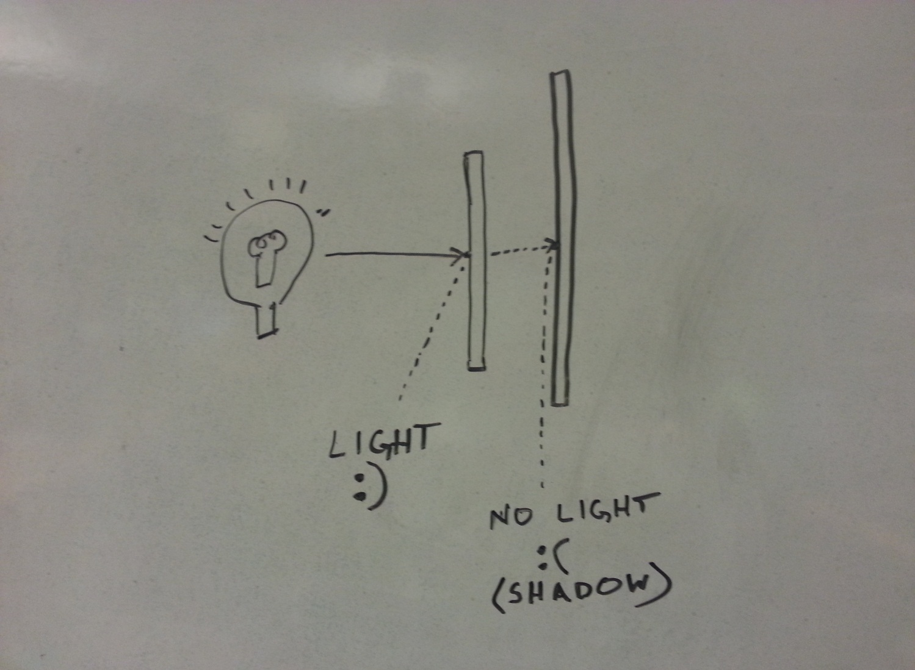
What is a Shadow?
Notes:
Absence of light is a shadow. A point on a surface is not visible because the effect of a light on the point is occluded by an object between the point and the light source.
Ambient light effects every point irrespective of number of lights and positions of objects

Slide 3
Light Source
Look At
Position
Field of View
World Up
Color
No intensity fall off
Notes:
Talk about the other methods tried
OpenGL (FLTK) + Ray Tracing
Texturing
Finally settled on Z.
Describe the Z buffering method for light sources
Light source had to be more ideal (directional, lookat, FOV). No intensity fall-off implemented.

Slide 4
Options Considered
Z
OpenGL (FLTK) + Ray Tracing
Texturing
Notes:
Talk about the other methods tried
OpenGL (FLTK) + Ray Tracing
Texturing
Finally settled on Z.
Describe the Z buffering method for light sources
Light source had to be more ideal (directional, lookat, FOV). No intensity fall-off implemented.

Slide 5
Core Algorithm
Populate Shadow Buffers.
Use shadow buffers for shading calculations during rendering.

Slide 6
Changes to GzRenderer
Old Code
New Code
while(!EOF)
{
putTriangle()
}
while(!EOF)
{
populateShadowBuf()
}
while(!EOF)
{
putTriangle()
}

Slide 7
Spaces: Existing
Model
World
Image
Perspective
Screen

Slide 8
Spaces: Step 1
Model
World
Image
Perspective
Screen
Light
Light Buffer

Slide 9
Spaces: Step 2
Model
World
Image
Perspective
Screen
Light
Light Buffer
?

Slide 10
Spaces: Step 2
Model
World
Image
Perspective
Screen
Light
Light Buffer

Slide 11
Efficiency
Each light takes processing time as much as the rendering process
Lesser the lights, faster the speed but lower the shadow quality
Shadow resolution is directly proportional to speed of rendering

Slide 12
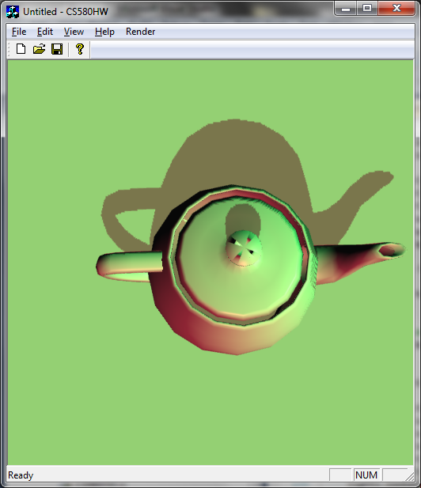

Slide 13
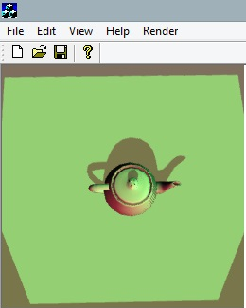
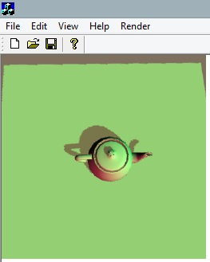
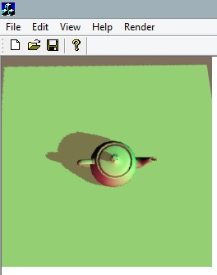

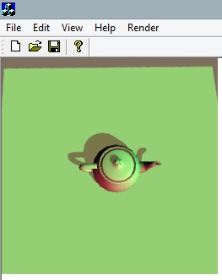
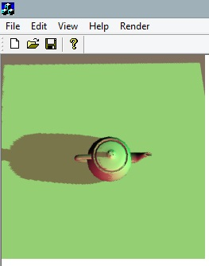

Slide 14
References
Lance Williams 1976. Casting Curved Shadows on Curved Surfaces. http://artis.imag.fr/Members/Cyril.Soler/DEA/Ombres/Papers/William.Sig78.pdf
Cass Everitt, Ashu Rege, Cem Cebenoyan. Hardware Shadow Mapping. http://www.cs.berkeley.edu/~ravir/6160/papers/shadow_mapping.pdf
Randima Fernando. Percentage-Closer Soft Shadows. http://developer.download.nvidia.com/shaderlibrary/docs/shadow_PCSS.pdf
Cascaded Shadow Maps 2008, NVidia 2008
http://en.wikipedia.org/wiki/Shadow_mapping

